Slide 1
Decrease-and-Conquer
Reduce problem instance to smaller instance of the same problem
Solve smaller instance
Extend solution of smaller instance to obtain solution to original instance
Can be implemented either top-down or bottom-up
Also referred to as inductive or incremental approach
A. Levitin “Introduction to the Design & Analysis of Algorithms,” 3rd ed., Ch. 4 ©2012 Pearson Education, Inc. Upper Saddle River, NJ. All Rights Reserved.

Slide 2
3 Types of Decrease and Conquer
Decrease by a constant (usually by 1):
  insertion sort
  topological sorting
  algorithms for generating permutations, subsets
Decrease by a constant factor (usually by half)
  binary search and bisection method
  exponentiation by squaring
  multiplication à la russe
Variable-size decrease
  Euclid’s algorithm
  selection by partition
  Nim-like games
A. Levitin “Introduction to the Design & Analysis of Algorithms,” 3rd ed., Ch. 4 ©2012 Pearson Education, Inc. Upper Saddle River, NJ. All Rights Reserved.

Slide 3



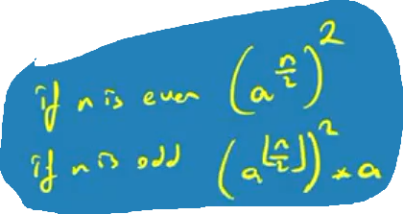
What’s the difference?
Consider the problem of exponentiation: Compute a^{n}
Brute Force:
Divide and conquer:
Decrease by one:
Decrease by constant factor:
A. Levitin “Introduction to the Design & Analysis of Algorithms,” 3rd ed., Ch. 4 ©2012 Pearson Education, Inc. Upper Saddle River, NJ. All Rights Reserved.
Notes:
Try to get the students involved in coming up with these:
Brute Force:
a^{n}= a*a*a*a*...*a
n
Divide and conquer:
a^{n}= a^{n/2} * a^{n/2} (more accurately, a^{n}= a^{⎣n/2⎦} * a ^{⎡n/2│})
Decrease by one:
a^{n}= a^{n-1}* a (one hopes a student will ask what is the difference with brute force here:
there is none in the resulting algorithm, of course, but you can arrive
at it in two different ways)
Decrease by constant factor:
a^{n}= (a^{n/2})² (again, if no student asks about it, be sure to point out the difference
with divide and conquer. Here there is a significant difference that leads to a
much more efficient algorithm – in divide and conquer we recompute a^{n/2}

Slide 4
Insertion Sort
To sort array A[0..n-1], sort A[0..n-2] recursively and
then insert A[n-1] in its proper place among the sorted
A[0..n-2]
Usually implemented bottom up (nonrecursively)
Example: Sort 6, 4, 1, 8, 5
6 | 4 1 8 5
4 6 | 1 8 5
1 4 6 | 8 5
1 4 6 8 | 5
1 4 5 6 8
A. Levitin “Introduction to the Design & Analysis of Algorithms,” 3rd ed., Ch. 4 ©2012 Pearson Education, Inc. Upper Saddle River, NJ. All Rights Reserved.

Slide 5
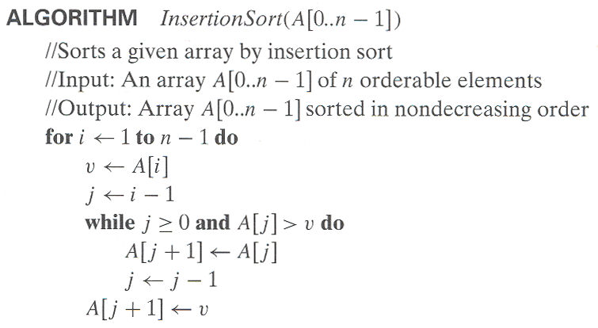
Pseudocode of Insertion Sort
A. Levitin “Introduction to the Design & Analysis of Algorithms,” 3rd ed., Ch. 4 ©2012 Pearson Education, Inc. Upper Saddle River, NJ. All Rights Reserved.

Slide 6
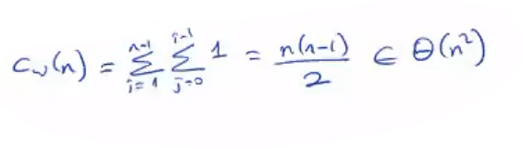
Analysis of Insertion Sort
Time efficiency
C_{worst}(n) = n(n-1)/2 ∈ Θ(n²)
C_{avg}(n) ≈ n²/4 ∈ Θ(n²)
C_{best}(n) = n - 1 ∈ Θ(n) (also fast on almost sorted arrays)
Space efficiency: in-place
Stability: yes
Best elementary sorting algorithm overall
Binary insertion sort
A. Levitin “Introduction to the Design & Analysis of Algorithms,” 3rd ed., Ch. 4 ©2012 Pearson Education, Inc. Upper Saddle River, NJ. All Rights Reserved.

Slide 7
Dags and Topological Sorting
A dag: a directed acyclic graph, i.e. a directed graph with no (directed) cycles
Arise in modeling many problems that involve prerequisite
constraints (construction projects, document version control)
Vertices of a dag can be linearly ordered so that for every edge
its starting vertex is listed before its ending vertex (topological sorting). Being a dag is also a necessary condition for topological sorting be possible.
a
b
a
b
a dag
not a dag
c
d
c
d
A. Levitin “Introduction to the Design & Analysis of Algorithms,” 3rd ed., Ch. 4 ©2012 Pearson Education, Inc. Upper Saddle River, NJ. All Rights Reserved.

Slide 8
Topological Sorting Example
Order the following items in a food chain
tiger
human
fish
sheep
shrimp
plankton
wheat
A. Levitin “Introduction to the Design & Analysis of Algorithms,” 3rd ed., Ch. 4 ©2012 Pearson Education, Inc. Upper Saddle River, NJ. All Rights Reserved.

Slide 9
DFS-based Algorithm
DFS-based algorithm for topological sorting
  Perform DFS traversal, noting the order vertices are popped off the traversal stack
  Reverse order solves topological sorting problem
  Back edges encountered?→ NOT a dag!
Example:
Efficiency:
a
b
c
d
e
f
g
h
A. Levitin “Introduction to the Design & Analysis of Algorithms,” 3rd ed., Ch. 4 ©2012 Pearson Education, Inc. Upper Saddle River, NJ. All Rights Reserved.

Slide 10
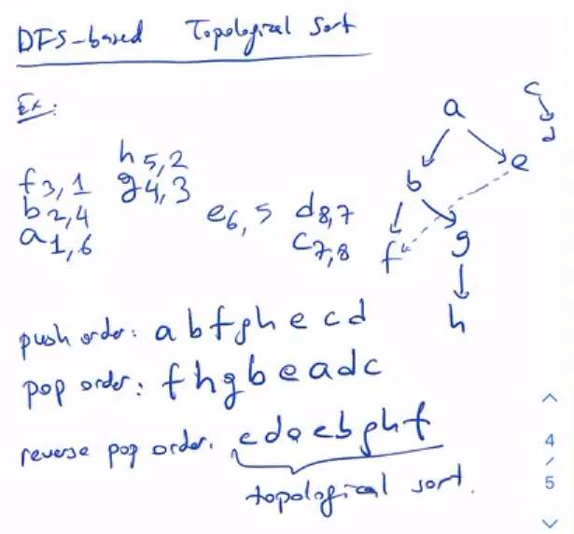
DFS-based Algorithm
a
b
c
d
e
f
g
h
A. Levitin “Introduction to the Design & Analysis of Algorithms,” 3rd ed., Ch. 4 ©2012 Pearson Education, Inc. Upper Saddle River, NJ. All Rights Reserved.

Slide 11
Source Removal Algorithm
Source removal algorithm
  Repeatedly identify and remove a source (a vertex with no incoming edges) and all the edges incident to it until either no vertex is left (problem is solved) or there is no source among remaining vertices (not a dag)
Example:
Efficiency: same as efficiency of the DFS-based algorithm
a
b
c
d
e
f
g
h
A. Levitin “Introduction to the Design & Analysis of Algorithms,” 3rd ed., Ch. 4 ©2012 Pearson Education, Inc. Upper Saddle River, NJ. All Rights Reserved.

Slide 12
Generating Permutations
Minimal-change decrease-by-one algorithm
If n = 1 return 1; otherwise, generate recursively the list of all permutations of 12…n-1 and then insert n into each of those permutations by starting with inserting n into 12...n-1 by moving right to left and then switching direction for each new permutation
Example: n=3
start 1
insert 2 into 1 right to left 12 21
insert 3 into 12 right to left 123 132 312
insert 3 into 21 left to right 321 231 213
A. Levitin “Introduction to the Design & Analysis of Algorithms,” 3rd ed., Ch. 4 ©2012 Pearson Education, Inc. Upper Saddle River, NJ. All Rights Reserved.

Slide 13
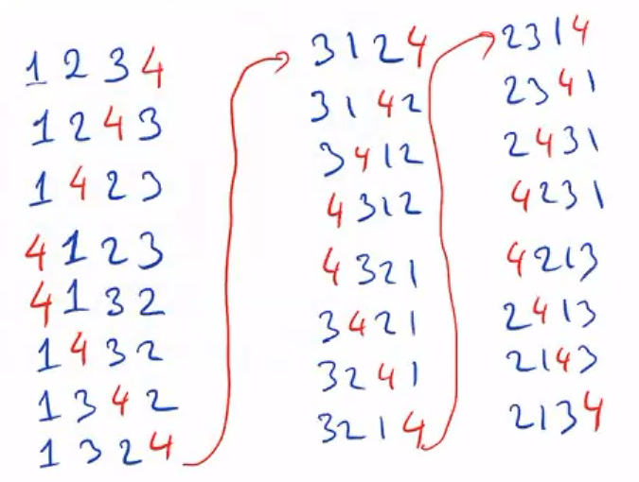
Other permutation generating algorithms
Johnson-Trotter (p. 145)
Lexicographic-order algorithm (p. 146)
Heap’s algorithm (Problem 4 in Exercises 4.3)
A. Levitin “Introduction to the Design & Analysis of Algorithms,” 3rd ed., Ch. 4 ©2012 Pearson Education, Inc. Upper Saddle River, NJ. All Rights Reserved.

Slide 14
Generating Subsets
Binary reflected Gray code: minimal-change algorithm for generating 2^{n} bit strings corresponding to all the subsets of an n-element set where n > 0
If n=1 make list L of two bit strings 0 and 1
else
generate recursively list L1 of bit strings of length n-1
copy list L1 in reverse order to get list L2
add 0 in front of each bit string in list L1
add 1 in front of each bit string in list L2
append L2 to L1 to get L
return L
A. Levitin “Introduction to the Design & Analysis of Algorithms,” 3rd ed., Ch. 4 ©2012 Pearson Education, Inc. Upper Saddle River, NJ. All Rights Reserved.

Slide 15
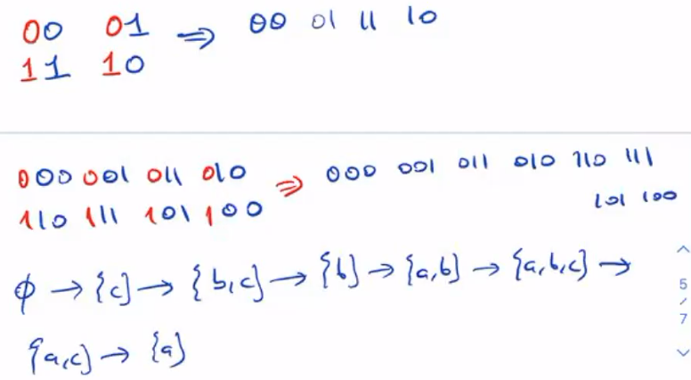
Generating Subsets
A. Levitin “Introduction to the Design & Analysis of Algorithms,” 3rd ed., Ch. 4 ©2012 Pearson Education, Inc. Upper Saddle River, NJ. All Rights Reserved.

Slide 16
Decrease-by-Constant-Factor Algorithms
In this variation of decrease-and-conquer, instance size is reduced by the same factor (typically, 2)
Examples:
binary search and the method of bisection
exponentiation by squaring
multiplication à la russe (Russian peasant method)
fake-coin puzzle
Josephus problem
A. Levitin “Introduction to the Design & Analysis of Algorithms,” 3rd ed., Ch. 4 ©2012 Pearson Education, Inc. Upper Saddle River, NJ. All Rights Reserved.

Slide 17
Binary Search
Very efficient algorithm for searching in sorted array:
K
vs
A[0] . . . A[m] . . . A[n-1]
If K = A[m], stop (successful search); otherwise, continue
searching by the same method in A[0..m-1] if K < A[m]
and in A[m+1..n-1] if K > A[m]
l ← 0; r ← n-1
while l ≤ r do
m ← ⎣(l+r)/2⎦
if K = A[m] return m
else if K < A[m] r ← m-1
else l ← m+1
return -1
A. Levitin “Introduction to the Design & Analysis of Algorithms,” 3rd ed., Ch. 4 ©2012 Pearson Education, Inc. Upper Saddle River, NJ. All Rights Reserved.

Slide 18
Analysis of Binary Search
Time efficiency
  worst-case recurrence: C_{w} (n) = 1 + C_{w}( ⎣n/2⎦ ), C_{w} (1) = 1
  solution: C_{w}(n) = ⎡log₂(n+1)⎤
  This is VERY fast: e.g., C_{w}(10⁶) = 20
Optimal for searching a sorted array
Limitations: must be a sorted array (not linked list)
Bad (degenerate) example of divide-and-conquer
Has a continuous counterpart called bisection method for solving equations in one unknown f(x) = 0 (see Sec. 12.4)
A. Levitin “Introduction to the Design & Analysis of Algorithms,” 3rd ed., Ch. 4 ©2012 Pearson Education, Inc. Upper Saddle River, NJ. All Rights Reserved.

Slide 19
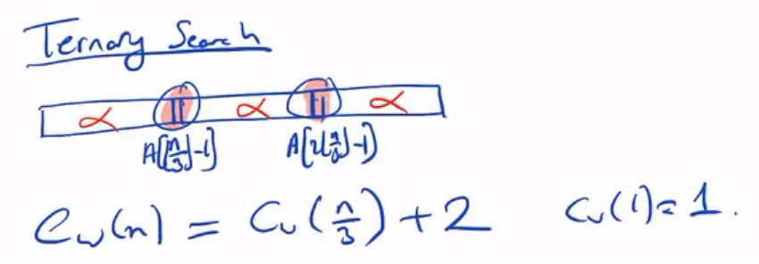
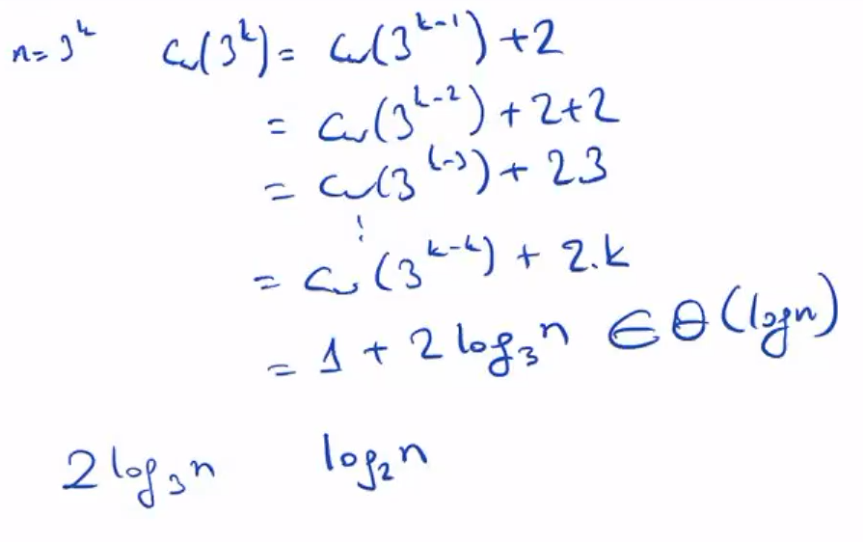
A. Levitin “Introduction to the Design & Analysis of Algorithms,” 3rd ed., Ch. 4 ©2012 Pearson Education, Inc. Upper Saddle River, NJ. All Rights Reserved.

Slide 20
Exponentiation by Squaring
The problem: Compute a^{n} where n is a nonnegative integer
The problem can be solved by applying recursively the formulas:
For even values of n
a ^{n} = (a ^{n/2} )² if n > 0 and a ⁰ = 1
For odd values of n
a ^{n} = (a ^{(n-1)/2} )² a
Recurrence: M(n) = M( ⎣n/2⎦ ) + f(n), where f(n) = 1 or 2,
M(0) = 0
Master Theorem: M(n) ∈ Θ(log n) = Θ(b) where b = ⎡log₂(n+1)⎤
A. Levitin “Introduction to the Design & Analysis of Algorithms,” 3rd ed., Ch. 4 ©2012 Pearson Education, Inc. Upper Saddle River, NJ. All Rights Reserved.

Slide 21
Russian Peasant Multiplication
The problem: Compute the product of two positive integers
Can be solved by a decrease-by-half algorithm based on the following formulas.
For even values of n:
n 2
n * m = * 2m
For odd values of n:
n – 1
2
n * m = * 2m + m if n > 1 and m if n = 1
A. Levitin “Introduction to the Design & Analysis of Algorithms,” 3rd ed., Ch. 4 ©2012 Pearson Education, Inc. Upper Saddle River, NJ. All Rights Reserved.

Slide 22
Example of Russian Peasant Multiplication
Compute 20 * 26
n m
20 26
10 52
5 104 104
2 208 +
1 416 416
520
Note: Method reduces to adding m’s values corresponding to
odd n’s.
A. Levitin “Introduction to the Design & Analysis of Algorithms,” 3rd ed., Ch. 4 ©2012 Pearson Education, Inc. Upper Saddle River, NJ. All Rights Reserved.

Slide 23
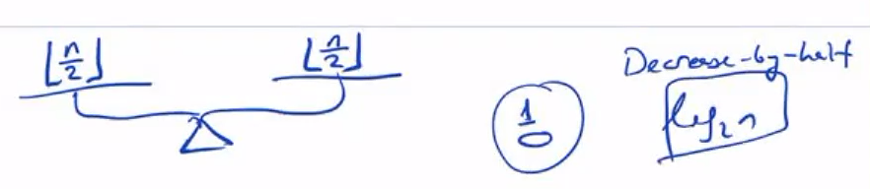
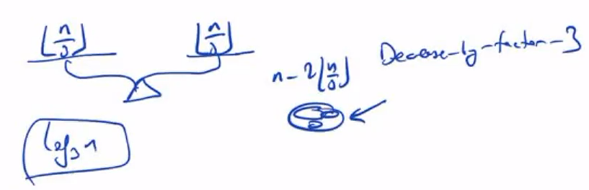
Fake-Coin Puzzle (simpler version)
There are n identically looking coins one of which is fake.
There is a balance scale but there are no weights; the scale can tell whether two sets of coins weigh the same and, if not, which of the two sets is heavier (but not by how much). Design an efficient algorithm for detecting the fake coin. Assume that the fake coin is known to be lighter than the genuine ones.
Decrease by factor 2 algorithm
Decrease by factor 3 algorithm
A. Levitin “Introduction to the Design & Analysis of Algorithms,” 3rd ed., Ch. 4 ©2012 Pearson Education, Inc. Upper Saddle River, NJ. All Rights Reserved.

Slide 24
Variable-Size-Decrease Algorithms
In the variable-size-decrease variation of decrease-and-conquer, instance size reduction varies from one iteration to another
Examples:
Euclid’s algorithm for greatest common divisor
partition-based algorithm for selection problem
interpolation search
some algorithms on binary search trees
Nim and Nim-like games
A. Levitin “Introduction to the Design & Analysis of Algorithms,” 3rd ed., Ch. 4 ©2012 Pearson Education, Inc. Upper Saddle River, NJ. All Rights Reserved.

Slide 25
Euclid’s Algorithm
Euclid’s algorithm is based on repeated application of equality
gcd(m, n) = gcd(n, m mod n)
Ex.: gcd(80,44) = gcd(44,36) = gcd(36, 12) = gcd(12,0) = 12
One can prove that the size, measured by the second number,
decreases at least by half after two consecutive iterations.
Hence, T(n) ∈ O(log n)
A. Levitin “Introduction to the Design & Analysis of Algorithms,” 3rd ed., Ch. 4 ©2012 Pearson Education, Inc. Upper Saddle River, NJ. All Rights Reserved.

Slide 26
Selection Problem
Find the k-th smallest element in a list of n numbers
k = 1 or k = n
median: k = ⎡n/2⎤
Example: 4, 1, 10, 9, 7, 12, 8, 2, 15 median = ?
The median is used in statistics as a measure of an average
value of a sample. In fact, it is a better (more robust) indicator
than the mean, which is used for the same purpose.
A. Levitin “Introduction to the Design & Analysis of Algorithms,” 3rd ed., Ch. 4 ©2012 Pearson Education, Inc. Upper Saddle River, NJ. All Rights Reserved.

Slide 27
Digression: Post Office Location Problem
Given n village locations along a straight highway, where should a new post office be located to minimize the average distance from the villages to the post office?
A. Levitin “Introduction to the Design & Analysis of Algorithms,” 3rd ed., Ch. 4 ©2012 Pearson Education, Inc. Upper Saddle River, NJ. All Rights Reserved.

Slide 28
Algorithms for the Selection Problem
The sorting-based algorithm: Sort and return the k-th element
Efficiency (if sorted by mergesort): Θ(nlog n)
A faster algorithm is based on the array partitioning:
Assuming that the array is indexed from 0 to n-1 and s is a split position obtained by the array partitioning:
If s = k-1, the problem is solved;
if s > k-1, look for the k-th smallest element in the left part;
if s < k-1, look for the (k-s)-th smallest element in the right part.
Note: The algorithm can simply continue until s = k-1.
s
all are ≤ A[s]
all are ≥ A[s]
A. Levitin “Introduction to the Design & Analysis of Algorithms,” 3rd ed., Ch. 4 ©2012 Pearson Education, Inc. Upper Saddle River, NJ. All Rights Reserved.

Slide 29
Two Partitioning Algorithms
There are two principal ways to partition an array:
One-directional scan (Lomuto’s partitioning algorithm)
Two-directional scan (Hoare’s partitioning algorithm)
A. Levitin “Introduction to the Design & Analysis of Algorithms,” 3rd ed., Ch. 4 ©2012 Pearson Education, Inc. Upper Saddle River, NJ. All Rights Reserved.

Slide 30
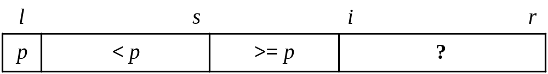
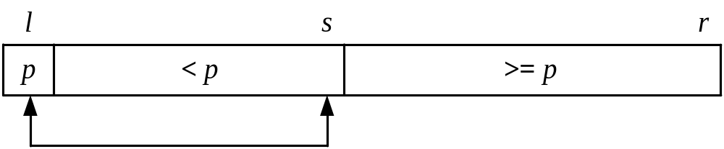
Lomuto’s Partitioning Algorithm
Scans the array left to right maintaining the array’s partition into three contiguous sections: < p, ≥ p, and unknown, where p is the value of the first element (the partition’s pivot).
On each iteration the unknown section is decreased by one element until it’s empty and a partition is achieved by exchanging the pivot with the element in the split position s.
A. Levitin “Introduction to the Design & Analysis of Algorithms,” 3rd ed., Ch. 4 ©2012 Pearson Education, Inc. Upper Saddle River, NJ. All Rights Reserved.

Slide 31
Tracing Lomuto’s Partioning Algorithm
s | i
4 | 1 | 10 | 8 | 7 | 12 | 9 | 2 | 15
 | s | i
4 | 1 | 10 | 8 | 7 | 12 | 9 | 2 | 15
 | s |  |  |  |  |  | i
4 | 1 | 10 | 8 | 7 | 12 | 9 | 2 | 15
 |  | s |  |  |  |  |  | i
4 | 1 | 2 | 8 | 7 | 12 | 9 | 10 | 15
 |  | s
4 | 1 | 2 | 8 | 7 | 12 | 9 | 10 | 15
2 | 1 | 4 | 8 | 7 | 12 | 9 | 10 | 15
A. Levitin “Introduction to the Design & Analysis of Algorithms,” 3rd ed., Ch. 4 ©2012 Pearson Education, Inc. Upper Saddle River, NJ. All Rights Reserved.

Slide 32
Tracing Quickselect (Partition-based Algorithm)
Find the median of 4, 1, 10, 9, 7, 12, 8, 2, 15
Here: n = 9, k = ⎡9/2⎤ = 5, k -1=4
0 | 1 | 2 | 3 | 4 | 5 | 6 | 7 | 8
4 | 1 | 10 | 8 | 7 | 12 | 9 | 2 | 15
2 | 1 | 4 | 8 | 7 | 12 | 9 | 10 | 15
 |  |  | 8 | 7 | 12 | 9 | 10 | 15
 |  |  | 7 | 8 | 12 | 9 | 10 | 15
after 1st partitioning: s=2<k-1=4
after 2nd partitioning: s=4=k-1
The median is A[4]= 8
A. Levitin “Introduction to the Design & Analysis of Algorithms,” 3rd ed., Ch. 4 ©2012 Pearson Education, Inc. Upper Saddle River, NJ. All Rights Reserved.

Slide 33


Efficiency of Quickselect
Average case (average split in the middle):
C(n) = C(n/2)+(n+1) C(n) ∈ Θ(n)
Worst case (degenerate split): C(n) ∈ Θ(n²)
A more sophisticated choice of the pivot leads to a complicated algorithm with Θ(n) worst-case efficiency.
A. Levitin “Introduction to the Design & Analysis of Algorithms,” 3rd ed., Ch. 4 ©2012 Pearson Education, Inc. Upper Saddle River, NJ. All Rights Reserved.

Slide 34
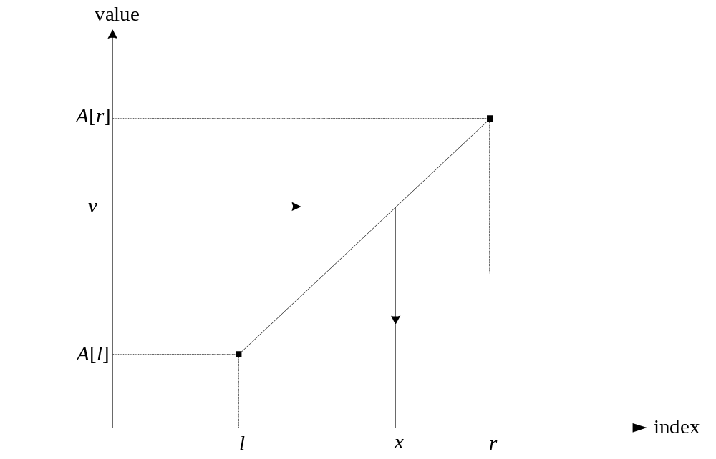
Interpolation Search
Searches a sorted array similar to binary search but estimates location of the search key in A[l..r] by using its value v. Specifically, the values of the array’s elements are assumed to grow linearly from A[l] to A[r] and the location of v is estimated as the x-coordinate of the point on the straight line through (l, A[l]) and (r, A[r]) whose y-coordinate is v:
x = l + ⎣(v - A[l])(r - l)/(A[r] – A[l] )⎦
A. Levitin “Introduction to the Design & Analysis of Algorithms,” 3rd ed., Ch. 4 ©2012 Pearson Education, Inc. Upper Saddle River, NJ. All Rights Reserved.

Slide 35
Analysis of Interpolation Search
Efficiency
average case: C(n) < log₂ log₂ n + 1
worst case: C(n) = n
Preferable to binary search only for VERY large arrays and/or expensive comparisons
Has a counterpart, the method of false position (regula falsi), for solving equations in one unknown (Sec. 12.4)
A. Levitin “Introduction to the Design & Analysis of Algorithms,” 3rd ed., Ch. 4 ©2012 Pearson Education, Inc. Upper Saddle River, NJ. All Rights Reserved.

Slide 36
Binary Search Tree Algorithms
Several algorithms on BST requires recursive processing of just one of its subtrees, e.g.,
Searching
Insertion of a new key
Finding the smallest (or the largest) key
k
<k
>k
A. Levitin “Introduction to the Design & Analysis of Algorithms,” 3rd ed., Ch. 4 ©2012 Pearson Education, Inc. Upper Saddle River, NJ. All Rights Reserved.

Slide 37
Searching in Binary Search Tree
Algorithm BTS(x, v)
//Searches for node with key equal to v in BST rooted at node x
if x = NIL return -1
else if v = K(x) return x
else if v < K(x) return BTS(left(x), v)
else return BTS(right(x), v)
Efficiency
worst case: C(n) = n
average case: C(n) ≈ 2ln n ≈ 1.39log₂ n
A. Levitin “Introduction to the Design & Analysis of Algorithms,” 3rd ed., Ch. 4 ©2012 Pearson Education, Inc. Upper Saddle River, NJ. All Rights Reserved.

Slide 38
One-Pile Nim
There is a pile of n chips. Two players take turn by removing from the pile at least 1 and at most m chips. (The number of chips taken can vary from move to move.) The winner is the player that takes the last chip. Who wins the game – the player moving first or second, if both player make the best moves possible?
It’s a good idea to analyze this and similar games “backwards”, i.e., starting with n = 0, 1, 2, …
A. Levitin “Introduction to the Design & Analysis of Algorithms,” 3rd ed., Ch. 4 ©2012 Pearson Education, Inc. Upper Saddle River, NJ. All Rights Reserved.

Slide 39
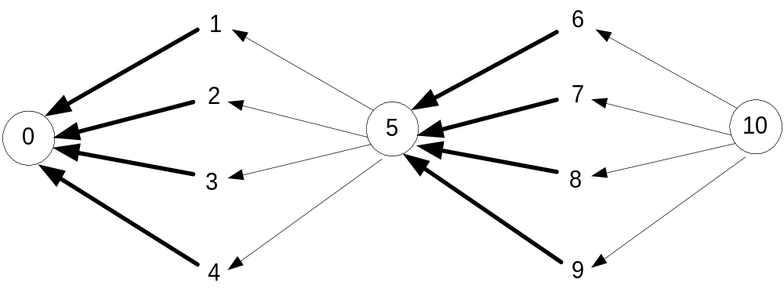
Partial Graph of One-Pile Nim with m = 4
Vertex numbers indicate n, the number of chips in the pile. The losing position for the player to move are circled. Only winning moves from a winning position are shown (in bold).
Generalization: The player moving first wins iff n is not a
multiple of 5 (more generally, m+1); the
winning move is to take n mod 5 (n mod (m+1))
chips on every move.
A. Levitin “Introduction to the Design & Analysis of Algorithms,” 3rd ed., Ch. 4 ©2012 Pearson Education, Inc. Upper Saddle River, NJ. All Rights Reserved.

